Slide 1
Graph-Transformation Verification using Monadic 2nd-Order Logic
Kazuhiro Inaba
with S. Hidaka, Z. Hu, H. Kato
(National Institute of Informatics, Japan)
and K. Nakano
(University of Electro-Communications)
PPDP 2011, Odense
Graph
MSO
Verify

Slide 2
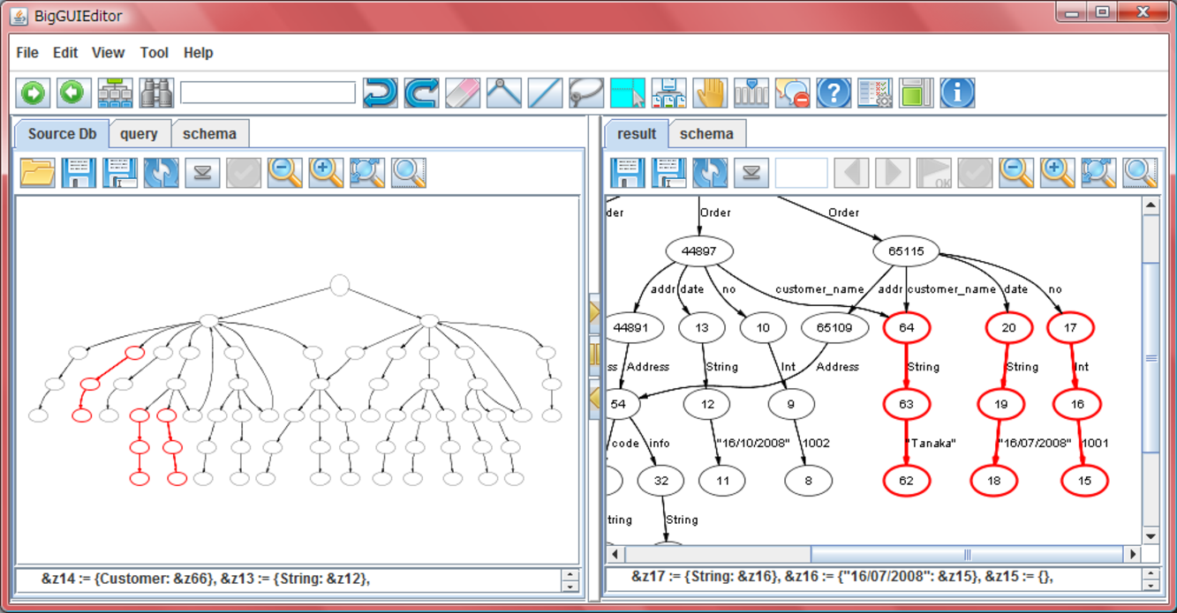
Graph Transformation
GRoundTram ( www.biglab.org )

Slide 3
Two Languages Involved
Transformation:
UnQL / UnCAL [Buneman&Fernandez&Suciu, 2000]
select {result: $x} where { _*: $x}, {name: John} in $x
Schema: KM3 [ATLAS Group]
class INPUT
{ reference SNS: SNSDB; … }
class OUTPUT
{ reference result*: MEM; }

Slide 4
Today’s Topic: Static Check
Given
  A graph transformation f
  Input schema S_{I}
  Output schema S_{o}
Statically verify that “there’s no type error”,
i.e., “for any graph g conforming to S_{I} ,
f(g) always conforms to S_{o}.”

Slide 5
Example : SNS-Members
Extract all members using the screen-name “John”.
SNS
member
name
John
friend
info
・・・
friend
member
name
Mary
select {result: $x}
where
{SNS: {member: $x}},
{name: John} in $x
info
・・・
member
friend
name
John
info
・・・
・・・

Slide 6
Example
Extract all members using the screen-name “John”.
SNS
member
name
John
result
friend
info
・・・
friend
member
result
name
Mary
select {result: $x}
where
{SNS: {member: $x}},
{name: John} in $x
info
・・・
member
friend
name
John
info
・・・
・・・

Slide 7
Example
Lazy programmer may write …
SNS
member
name
John
result
friend
info
・・・
friend
member
result
name
Mary
select {result: $x}
where
{ _*: $x},
{name: John} in $x
info
・・・
member
friend
name
John
info
・・・
・・・

Slide 8
Example
In fact, the graph contained “group” data, too!
SNS
member
name
John
friend
info
・・・
friend
member
group
group
name
Mary
member
info
・・・
member
friend
name
name
member
name
John
“Fan Club
of XXX”
“Java Programmer”
info
・・・
・・・

Slide 9
Example
What happens if there’s {group: {name: John, …}}
SNS
member
name
John
friend
info
・・・
friend
member
BUGGY!
group
group
name
Mary
select {result: $x}
where
{ _*: $x},
{name: John} in $x
member
info
・・・
member
friend
name
name
member
name
John
“Fan Club
of XXX”
“Java Programmer”
info
・・・
・・・

Slide 10
What We Provide
Programmers specify their intention
about the structure of input/output.
class OUTPUT { reference result*: MEM; }
// Input Schema supplied by the SNS provider
class INPUT { reference SNS: SNSDB; }
class SNSDB { reference member*: MEM;
reference group*: GRP; }
class MEM { reference friend*: MEM;
reference name: STRING; }
class GRP { reference name: STRING;
reference member*: MEM; }

Slide 11
What We Provide
Then, our system automatically verify it!
class INPUT {
reference SNS: SNSDB; }
“OK!”
select {result: $x}
where
{SNS: {member: $x}},
{name: John} in $x
※ Our checker is SOUND.
If it says OK, then the program never goes wrong.
class OUTPUT {
reference result*: MEM; }

Slide 12
What We Provide
Then, our system automatically verify it!
“BUG!”
class INPUT {
reference SNS: SNSDB; }
SNS
select {result: $x}
where
{ _*: $x},
{name: John} in $x
group
name
John
class OUTPUT {
reference result*: MEM; }
※ Our checker provides
a COUNTER-EXAMPLE.

Slide 13
Outline of the Rest of the Talk
How We Implemented This Verification
  Monadic 2nd-Order Logic (MSO)
  Schema to MSO
  Transformations to MSO
  Decide MSO: from Graphs to Trees

Slide 14
Overall Picture
This Work
KM3 Schema
[ATLAS Group]
MSO Logic
MSO Definable
Transduction
[Courcelle 94]
UnQL / UnCAL
[Buneman, et.al. 00]
Nice Properties
Bwd Inference
MONA : MSO Solver
[Møller, et.al. 95-]

Slide 15
Monadic 2nd-Order Logic
MSO is a usual 1st order logic on graphs …
… extended with
(primitives) edge_{foo}(x, e, y) start(x)
(connectives) ￢P P&Q P∨Q ∀x.P(x) ∃x.P(x)
(set-quantifiers) ∀^{set}S. P(S) ∃^{set}S.P(S)
(set-primitives) x ∈ S S⊆T

Slide 16
Schema to MSO
Straightforward
class OUTPUT { reference result*: MEM; }
class MEM { reference friend*: MEM;
reference name: STRING; }
∃^{set}OUTPUT. ∃^{set}MEM.
(∀x. start(x) → x∈OUTPUT)
∧ (∀x∈OUTPUT. ∀e. ∀u.
edge(x,e,u) → edge_{result}(x,e,u) & u∈MEM)
∧ …

Slide 17
Transformation to MSO
Q: What do we mean by
“representing transformations in MSO”?
A: We convert UnQL’s functional core language
into a (kind of) logic program in MSO.
select {result: $x}
where
{ _*: $x},
{name: John} in $x
edge[OUT]_{b} (v, e, u) ⇔
∃v’ e’ u’. edge_{a}(v’,e’,u’) & v=v’ & e=e’ & u=e’
edge[OUT]_{d} (v, e, u) ⇔
∃v’ e’ u’. ￢edge_{a}(v’,e’,u’) & v=v’ & e=e’ & u=u’
…

Slide 18
Transformation Language
select {result: $x}
where
{ _*: $x},
{name: John} in $x
“Core UnCAL”
  Internal Representation of “UnQL” ➔
E ::= {L₁:E₁, L₂:E₂, …, L_{n}:E_{n}}
| if L=L then E else E
| $G
| &
| rec(λ($L,$G). E)(E) | …
L ::= (label constant)
| $L

Slide 19
Semantics of rec in UnCAL
rec(λ($L,$G).
if $L = a then {b: {c: &}}
else {d: $G}
)($input_graph)
b
c
a
1
2
d
Glue them!
1
z
2
a
b
c
a
1
2
1
2
if $L = a then {b: {c: &}}
else {d: $G}
1
2
z
1
2
1
2
Decompose to
a set of edges!
z
d

Slide 20
More Precise, MSO-Representable
“Finite-Copy” Semantics
a
if $L = a then {b: {c: &}}
else {d: $G}
b
c
1
2
1
2
Copy as needed!
Glue them!
b
Transform to
what we want!
c
1
2
1
2
edge[112]_{b} (v, e, u) ⇔
∃v’ e’ u’. edge_{a}(v’,e’,u’) & v=v’ & e=e’ & u=e’
edge[231]_{c}(v, e, u) ⇔
∃v’ e’ u’. edge_{a}(v’,e’,u’) & v=e’ & e=e’ & u=u’

Slide 21
“Finite-Copy” Semantics
if $L = a then {b: {c: &}}
else {d: $G}
1
2
1
2
z
d
Copy as needed!
Glue them!
Transform to
what we want!
d
2
2
edge[110]_{d}(v, e, u) ⇔
∃v’ e’ u’. ￢edge_{a}(v’,e’,u’) & v=v’ & e=e’ & u=u’

Slide 22
Transformation to MSO
Theorem:
Nest-free UnCAL is representable by
finite-copying MSO transduction.
  ((Transformation = Definition of
  the output-graph in terms of the input graph))
rec(λ($L,$G).
if $L = a
then {b: {c: &}}
else {d: $G}
)($input_db)
edge[112]_{b} (v, e, u) ⇔
∃v’ e’ u’. edge_{a}(v’,e’,u’) & v=v’ & e=e’ & u=e’
edge[231]_{c} (v, e, u) ⇔
∃v’ e’ u’. edge_{a}(v’,e’,u’) & v=e’ & e=e’ & u=u’
edge[110]_{d} (v, e, u) ⇔
∃v’ e’ u’. ￢edge_{a}(v’,e’,u’) & v=v’ & e=e’ & u=u’

Slide 23
“Backward” Inference [Courcelle 1994]
Transformation
Output Schema
rec(λ($L,$G).
if $L = a then {b: {c: &}} else {d: $G}
)($input_db)
∃e. edge_{c}(_, e, _)
edge[112]_{b} (v, e, u) ⇔ ∃v’ e’ u’. …
edge[231]_{c} (v, e, u) ⇔
∃v’ e’ u’. edge_{a}(v’,e’,u’) & … & e=e’
edge[110]_{d} (v, e, u) ⇔ ∃v’ e’ u’. …
∃e. edge[_0_]_{c} (_, e, _)
∨ edge[_1_]_{c} (_, e, _)
∨ edge[_2_]_{c} (_, e, _)
∨ edge[_3_]_{c} (_, e, _)
∃e. false
∨ false
∨ false
∨ ∃v’ e’ u’. edge_{a}(v’,e’,u’) & … & e=e’
InputSchema
⇒
∃e. edge_{a}(_, e, _)

Slide 24
Nested rec
Nested rec (arising from “cross product”)
  cannot be encoded into finite-copy semantics
  Currently we ask
  programmer to
  add annotation ➔
select {p: {f: $G1, s:$G2}}
where {_: $G1} in $db,
{_ : $G2} in $db
rec(λ($L1,$G1).
rec(λ($L2,$G2).
{pair: {first: $G1, second: $G2}}
)($db)
)($db)
rec(λ($L1,$G1). rec(λ($L2,$G2).
{pair: {first: ($G1 :: MEM),
second: $G2}} …

Slide 25
Remark: Why MSO
It is expressive power is needed.
  Schemas can encode runs of automata, which is basically equivalent to MSO.
  Transformation also requires MSO power, for tracking edge-erasing.
It can be made decidable!
  In contrast to, e.g., FO+TC^{k} that can capture nested recs without annotation.

Slide 26
Two Nice Props of UnCAL
[Buneman et al. 2000] UnCAL is …
b
a
UnCAL Transformation
c
Unfolding
Unfolding
Bisimulation-generic
a
a
a
b
c
b
・・・ ∞
・・・ ∞
Cut
Cut
Compact
a
a
b
c
b
c
a
b
c
・・・
・・・

Slide 27
MSO Validation
Now we have a MSO Formula on Graphs.
MONA MSO Solver [Møller, et.al. 95-]
can decide validness of MSO on Finite Trees.
!
MSO (even 1st-Order Logic) on Graphs
is undecidable [Trakhtenbrot 1950].
Theorem: If MSO formula is Bisimulation-Generic and Compact, it is valid on graphs iff on finite trees.

Slide 28
Conclusion
Static verification of graph transformations via MSO
Future work :
  Complete checking w/o annotations.
  Support for full UnCAL (with data value comparison).
  Use MSO-Transduction semantics for checking other properties.
  Comprehensive experiments on performance.
class INPUT {
reference SNS: SNSDB; }
MSO
select {result: $x}
where { _*: $x},
{name: John} in $x
class OUTPUT {
reference result*: MEM; }
“YES”/
“NO”+

